Slide 1
Software Development Lifecycle
JD Kilgallin
CPSC:480
08/29/22
Pressman Ch 2-4
His forehead says "Do not develop my app" -Morty Smith, Rick and Morty. Adult Swim. 2019.

Slide 2
Learning Objectives
Software development process models
Phases of development and their elements
Common and historical software engineering methodologies
Evolution of software systems
Core DevOps concepts

Slide 3
How does software get developed?
A product is conceived to meet a business need.
Stakeholders communicate with a software engineering team to design and develop (the first version of) the product.
Work is scoped, broken down into tasks, and assigned to developers.
Code is written, built, tested, documented, released, and deployed.
Software starting here, from scratch, is called greenfield development.
Process is repeated to create the next version, or the team shifts to a different product. Work using a pre-existing codebase is brownfield.
The cycle of defining requirements, planning implementation, designing the product, implementing it, testing it, and releasing it for each iteration is the fundamental role of Software Engineering teams.

Slide 4
How does software development start?
Initial planning may precede the first cycle to scope the entire project.
Inception – Someone identifies a need for software to address a specific use case. May be software vendor executives deciding to launch a product based on perception of market need, or a customer seeking to hire a company to build a product.
Elicitation – Product team works to define basic requirements.
Elaboration – Requirement details filled in to understand exact needs.
Negotiation – Budgets, timelines, and resource availability considered
Specification – A full(ish) statement of the work to be performed.
Validation – Specification is confirmed to meet customer needs.

Slide 5
Software development process
A framework for the activities, actions, and tasks required to build high-quality software.
The approach that is taken as software is engineered.
A system in which tools and techniques are used to develop software.
A series of predictable steps to deliver quality software on time.
An iterative strategy for successful software release and evolution.

Slide 6
Software development activities
Communication (Requirements) – Deciding what the software will do
Planning – Deciding what needs to be done to achieve requirements, including allocation of time for product design/modeling
Modelling (Product Design) – Deciding how the software will be built
Construction
Implementation – Creating the software according to design
Validation (Testing, aka Quality Assurance (QA)) – Confirming the software meets requirements
Release (Deployment) – Delivering software package to the consumer

Slide 7
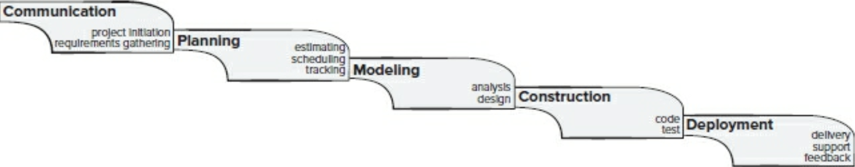
Waterfall model

Slide 8
Waterfall model pros and cons
1970's approach
Does not capture real projects and cannot be justified to stakeholders
Leaves many contributors with nothing to do for much of the project
Changing requirements significantly delay the entire project
Customer feedback cannot be gathered until the end
Does not allow for feedback to be incorporated in the first place!

Slide 9
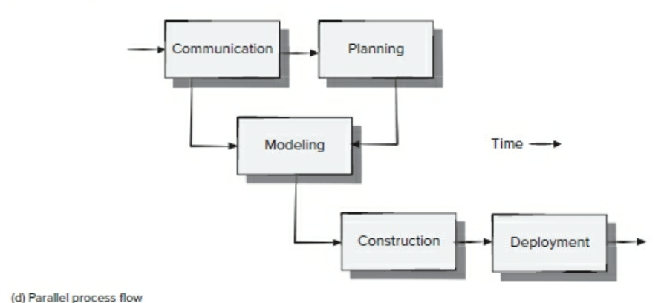
Parallel waterfall model

Slide 10
Parallel waterfall pros and cons
Less downtime: Contributors participate through most of the project
Changing requirements no longer delay implementation of unrelated elements.
However, customer feedback still cannot be gathered until the end, and cannot be effectively incorporated.

Slide 11
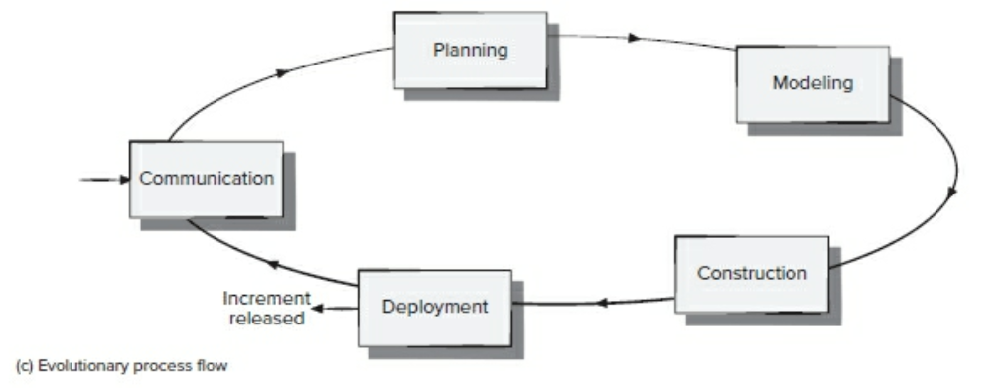
Prototyping model

Slide 12
Prototyping model pros and cons
Can be used with poorly-defined initial requirements
Customer feedback can be gathered and used quickly
Direction of product can shift easily
Features can be implemented in order of priority
Working to quickly develop a prototype leads to compromising on quality of design and of implementation – technical debt
Customers see what appears to be working software without understanding of technical debt and are less willing to allow for design and implementation improvements.
Little testing: software may function poorly outside of core use cases.

Slide 13
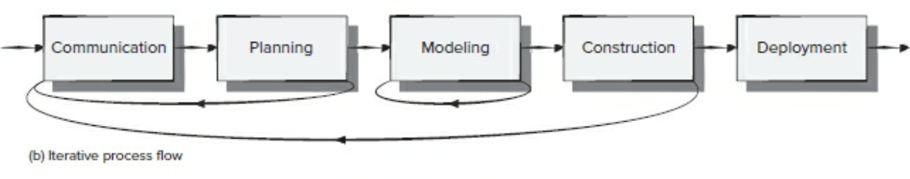
Iterative model
Reduces likelihood of significant technical debt.
Increased time spent on requirements, planning, and design upfront reduces cost of change without holding up construction of features ready to be implemented.
Starting to look like a simplified version of a realistic process.

Slide 14
Agile model
Philosophy and guidelines to reduce complexity and cost of development.
Variations widely used in the field today. Popular with developers.
Central concept is that traditional models fail to capture human factors of software development processes.
Acknowledges difficulty of predicting how requirements will evolve and that process phases cannot happen disjointly, even in parallel.
Aims to reduce the cost of change throughout the product lifetime.
Covers software team organization, work artifacts, & unpredictability.

Slide 15
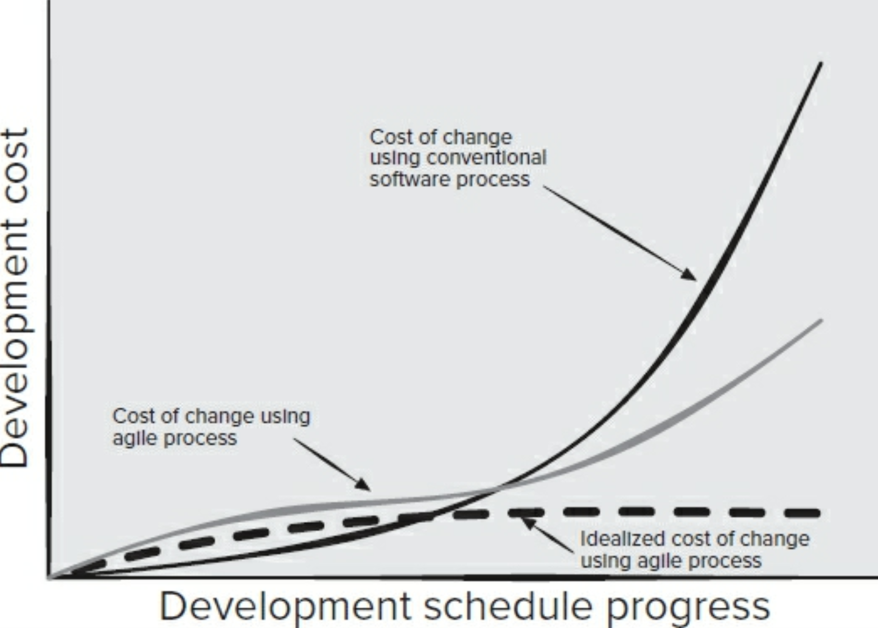

Slide 16
Agile Alliance Principles (paraphrased)
Highest priority is customer satisfaction.
Welcome changing requirements for competitive advantage.
Deliver working software as frequently as possible (down to 2 weeks).
Business and development staff must work together.
Get work done by giving motivated people a conducive environment.
Prefer face-to-face communication.
Working software is the primary measure of progress.
Promote an indefinitely-sustainable pace of development.
Continuously pay attention to technical excellence and good design.
Simplicity – maximizing the amount of work not done – is essential.
The best designs emerge from self-organizing teams.
Routinely reflect on how to become more effective and adjust accordingly.

Slide 17
Agile processes – (somewhat) common features
Scrum meetings – Short "stand-up" meetings at the beginning of each day to describe previous day's work, plans for that day, and obstacles.
Product backlog – A list of work tasks to be prioritized and assigned.
User stories – Capturing requirements in the form "As a ___, I want to ___"
Product owner – Responsible for backlog item definition and priority.
Sprints – A short, 2-4-week block in which selected work items and bug fixes are completed by developers, resulting in a software increment.
Sprint review meeting – Demonstrate features developed that sprint.
Sprint planning – Work to be done next sprint is estimated and assigned. No new work should be added to the sprint once it has begun.
Pair programming (XP) – Two developers, one computer for each item.
Task (Kanban) board – Table showing current status on each work item.

Slide 18
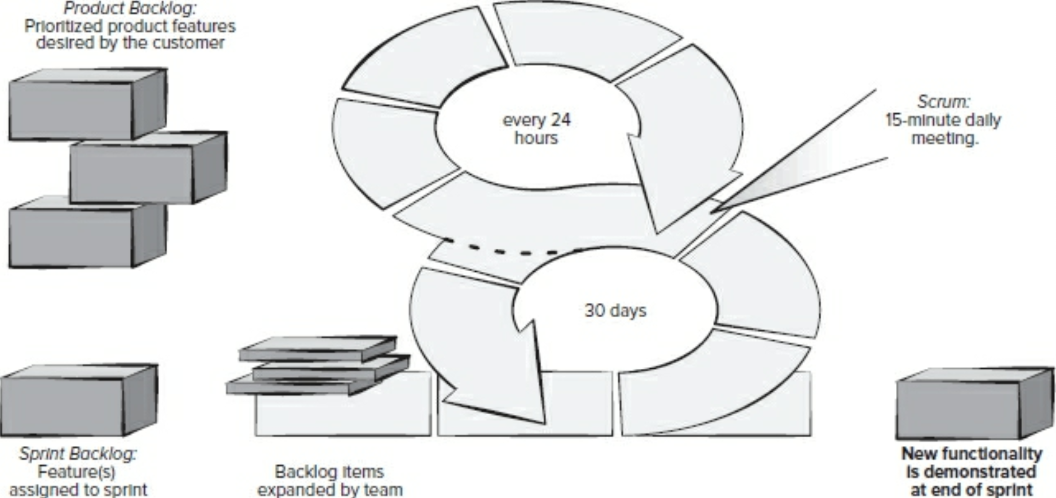

Slide 19
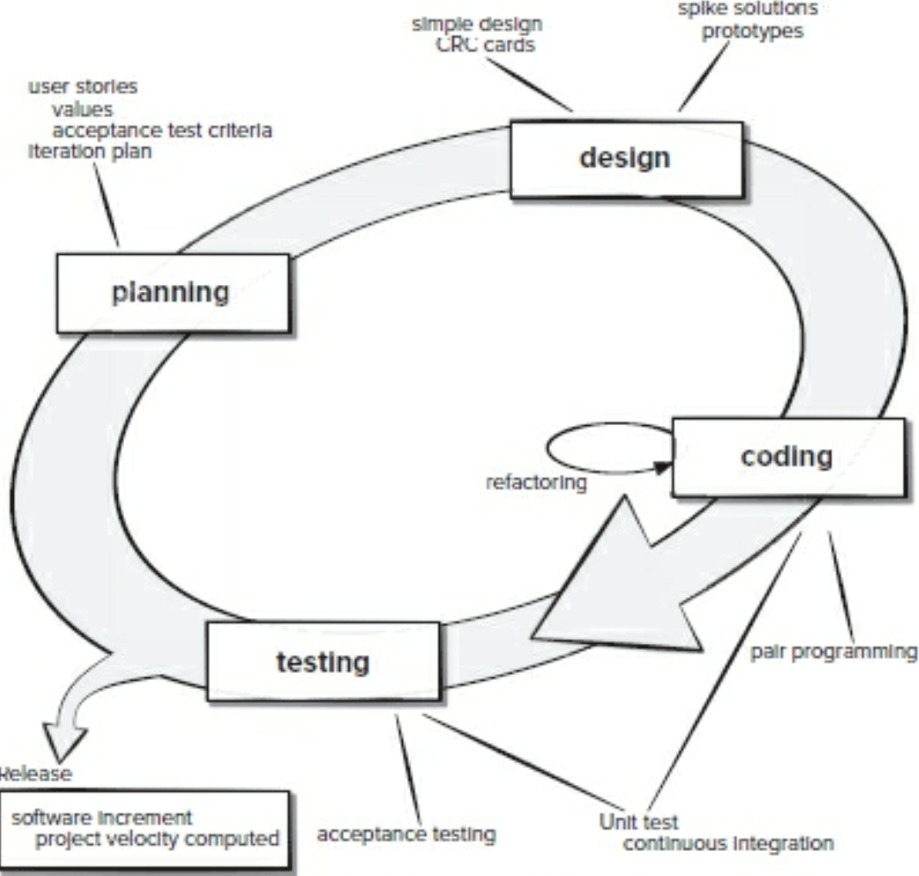

Slide 20
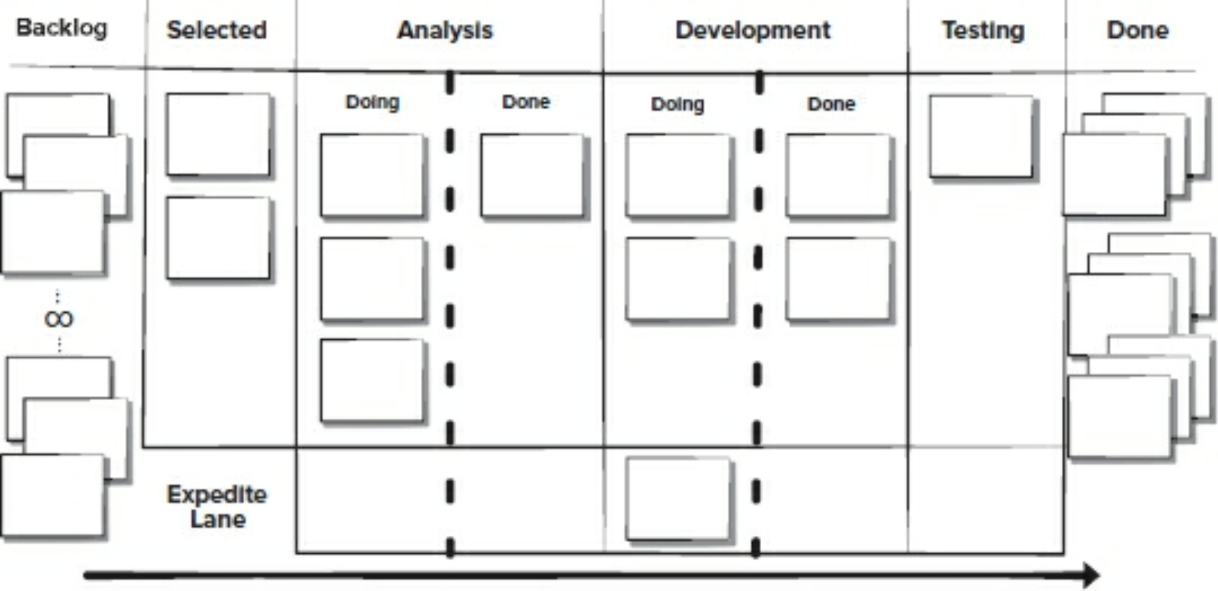

Slide 21
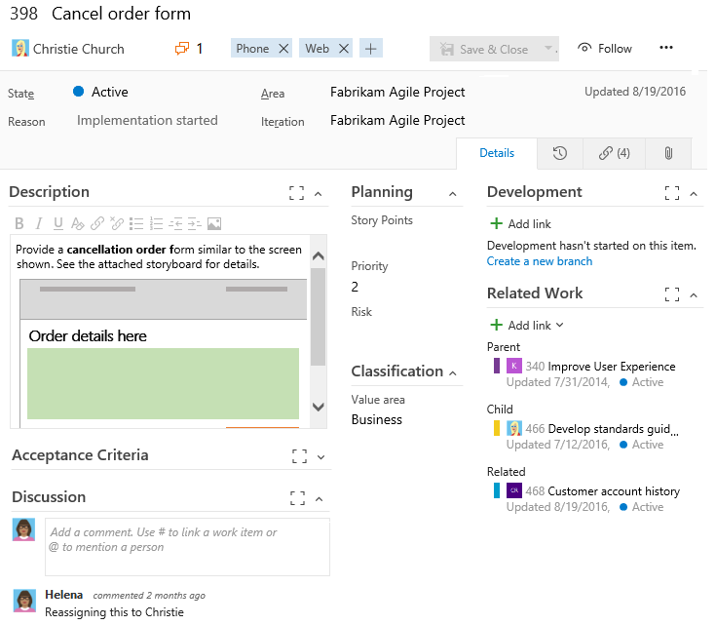

Slide 22
What happens after software is developed
Final release candidate built for internal and beta testing.
Final documentation and release notes compiled.
Marketing materials announcing new features are released.
Sales, operations, & partner-company staff is trained on new version.
When all required parties sign off on release, software, documentation, and related materials (e.g. containers) are packaged and distributed through applicable channels.
Support and operations staff begin working with the new version in production environments.
Maintenance of this version and development of next version begins.
Release retrospective identifies areas of process improvement and computes development velocity to assist with future time estimates.

Slide 23
Software maintenance
Occurs through the entire life of the product. More expensive than the original development due to the long duration.
Perfective maintenance occurs to proactively improve product performance, existing functionality, architecture, and documentation. This is often planned before the version to be maintained is released.
Corrective maintenance occurs in reaction to a bug or defect whose existence or impact is only identified after a release is deployed.
Adaptive maintenance occurs in reaction to changes in the environment in which the software needs to run (e.g. new version of underlying database server has new security requirements).
Preventive maintenance occurs to proactively fix potential issues before they cause impact to customers (e.g. developers, testers, or users find an exploitable, but not yet exploited, weakness in application security).

Slide 24
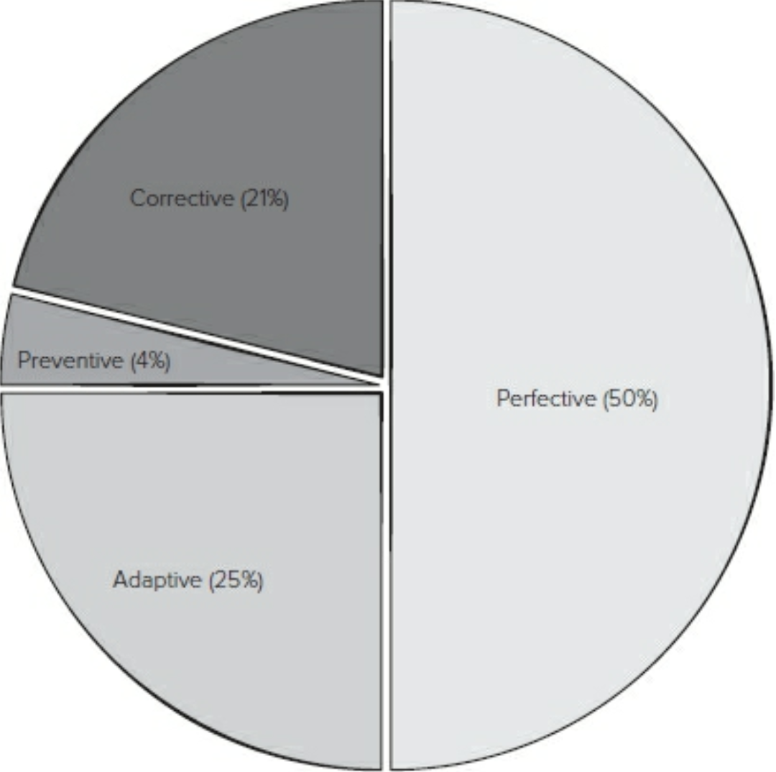

Slide 25
Evolution
Product development rarely stops with one released version.
Timelines prevent all desired features from being developed at once.
Additional versions are frequently planned before the first version is released.
Some current software systems have been around for decades
Voyager 2 probe, begun 1972
MOCAS US DoD contract management, 1958
GNU Emacs, 1984
C Pre-processor, 1978
Even after the last planned release, new versions of legacy software are sometimes developed later.

Slide 26
Lehman's 8 Laws of Software Evolution
Recall: An E-program is written to perform some real-world activity.
"Continuing Change" — An E-type system must be continually adapted or it becomes progressively less satisfactory.
"Increasing Complexity" — As an E-type system evolves, its complexity increases unless work is done to maintain or reduce it.
"Self-Regulation" — E-type system evolution processes are self-regulating, with the distribution of product and process measures close to normal.

Slide 27
Lehman's 8 Laws of Software Evolution
"Conservation of Organizational Stability" — The average effective global activity rate in an evolving E-type system is invariant over the product's lifetime.
"Conservation of Familiarity" — As an E-type system evolves, all associated with it must maintain mastery of its content and behavior to achieve satisfactory evolution. Excessive growth diminishes that mastery. Hence the average incremental growth remains invariant as the system evolves.

Slide 28
Lehman's 8 Laws of Software Evolution
"Continuing Growth" — The functional content of an E-type system must be continually increased to maintain user satisfaction over its lifetime.
"Declining Quality" — The quality of an E-type system will appear to be declining unless it is rigorously maintained and adapted to operational environment changes.
"Feedback System" — E-type evolution processes constitute multi-level, multi-loop, multi-agent feedback systems and must be treated as such to achieve significant improvement over any reasonable base.

Slide 29
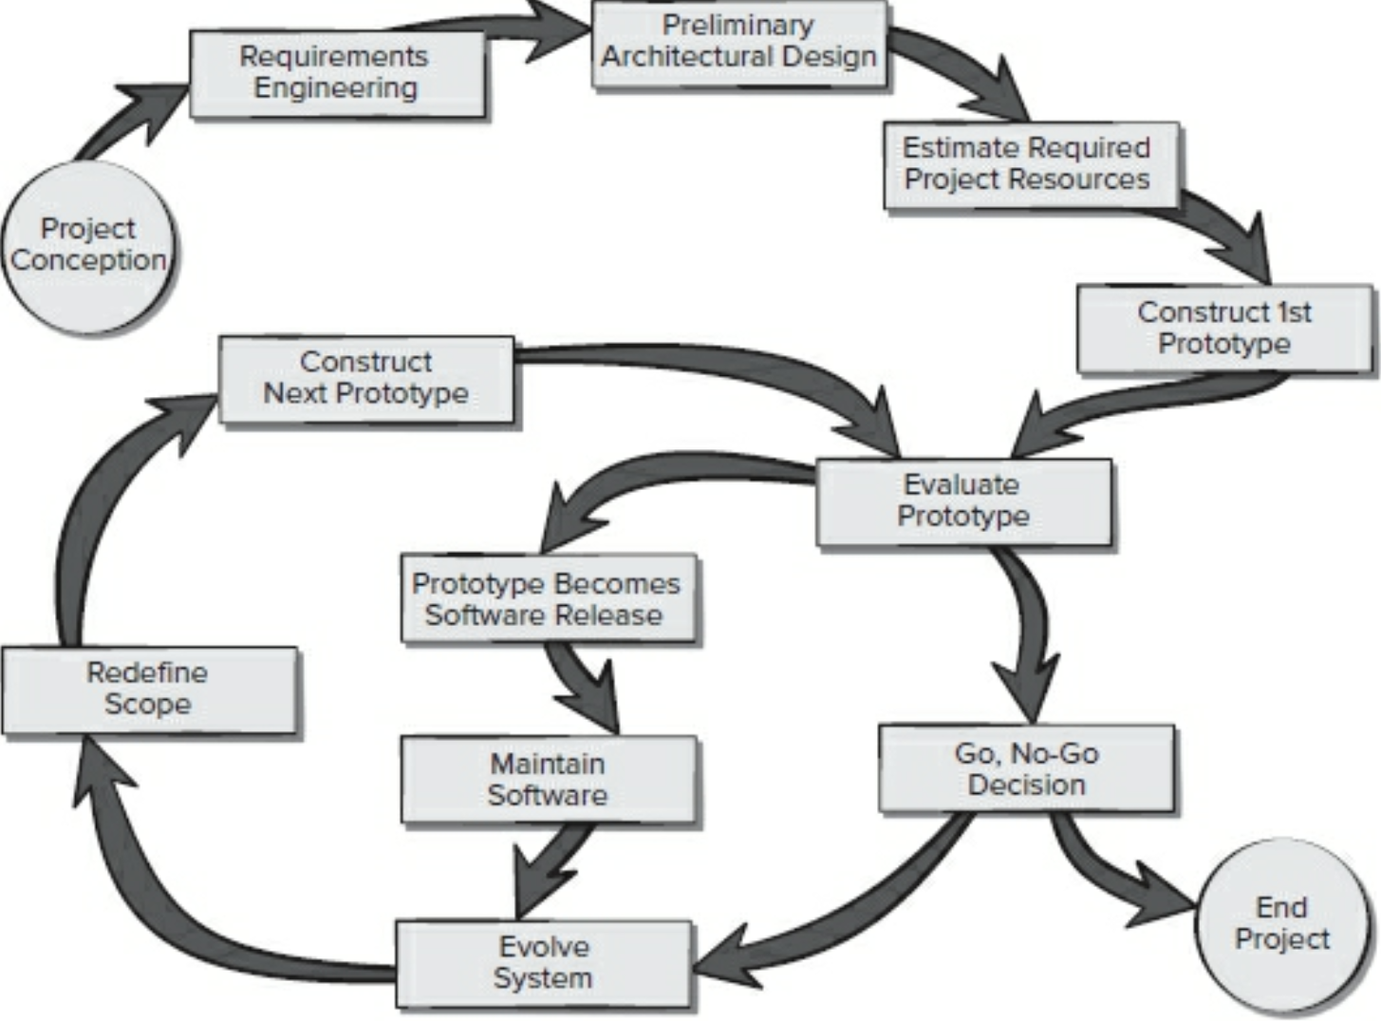

Slide 30
DevOps
Merging the disciplines of software Development and Operation.
Software development processes – even agile ones – do not capture the steps required in deploying and using the software.
Deployment of modern, complex cloud-native applications running in datacenters require extensive engineering of the operating environment itself.
Lack of coordination between software developers and operators leads to failures and inefficiencies, increasing cost of business.

Slide 31
DevOps – Infrastructure as code
The environment in which software runs in production is not well-reflected by the environment in which it is developed and tested.
Working configurations cannot easily be reproduced.
Specifying the environment configuration in the same way as program code allows known working configurations to be deployed, and effects of environment change can be predicted.
Infrastructure-as-code allows number of instances of software components to be scaled quickly to meet demand (e.g. Prime Day).
Amenable to modern cloud architectures, where functionality is achieved by composing independent microservices running as containers (virtualized hardware) in a datacenter.
i.e. "it works on my machine!" "Then let's ship your machine"

Slide 32
DevOps – CI/CD
When independent parts of large, complex systems are updated in isolation, incompatibilities can develop. This can happen even within a single application with many features.
The traditional process of upgrading deployed software can be risky and cumbersome, so updates of production software are infrequent and may not be used. Updates may cause unintended and irreversible effects.
Emergency updates (e.g. security patches) disrupt development teams.
Customers must wait extended periods on needed software updates.
DevOps stresses Continuous Integration and Continuous Deployment to mitigate the impact of these issues. Frequent, minimal changes reduce friction between software components users.
In a microservice architecture, new versions of components can be deployed alongside old versions to identify unintended effects with minimal customer impact.

Slide 33
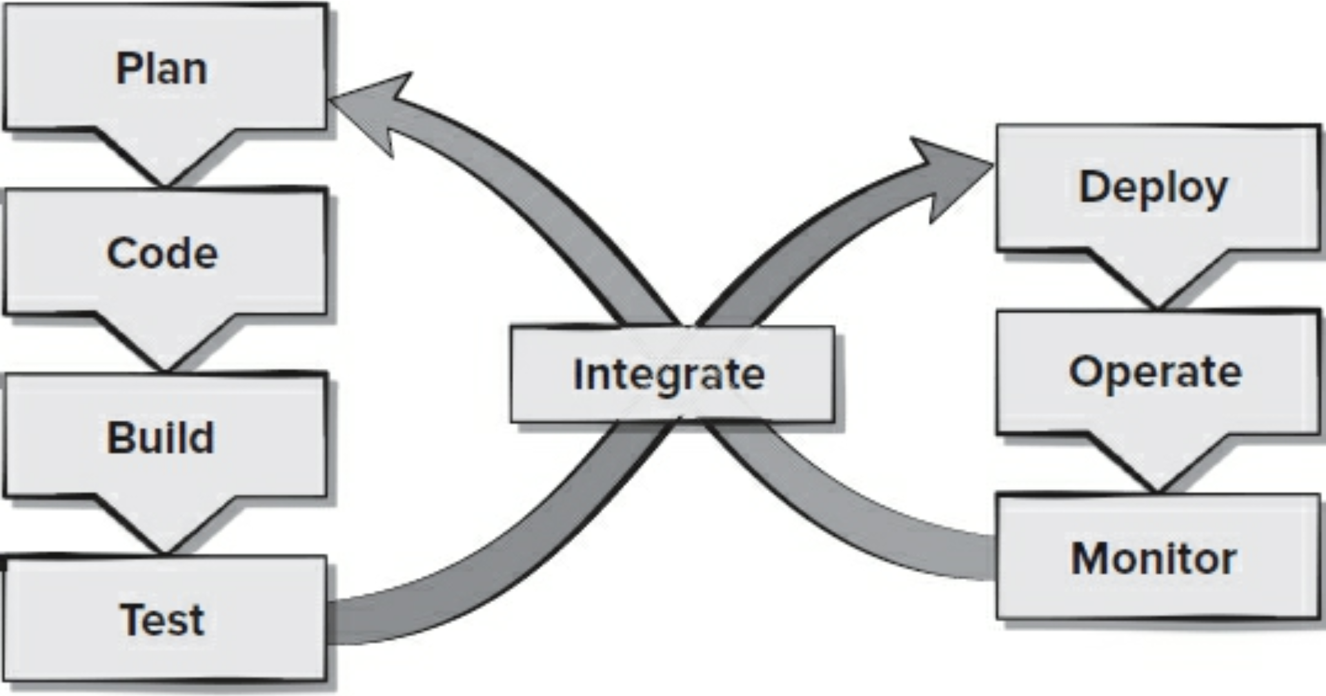

Slide 34
References
Managing the Development of Large Software Systems. Winston Royce. Aug 1970. Proceedings of IEEE WESCON.
The New Methodology. Martin Fowler. Dec 2005. MartinFowler.com.
12 principles behind the agile manifesto. Jul 2016. Agile Alliance.
What is the Oldest Computer Program Still in Use? Glenn Fleishman. Aug 2015. MIT Technology Review.
On understanding laws, evolution, and conservation in the large-program life cycle. Meir Lehman. Dec 1980. Journal of Systems and Software.
Reading for next lecture: Pressman Ch 5, 24, Problems - LeetCode

